Slide 1
AVL Tree Building Example
Insert(1)
1

Slide 2
AVL Tree Building Example
Insert(2)
1
2

Slide 3
AVL Tree Building Example
Insert(3) single left rotation
1
-2
2
3

Slide 4
AVL Tree Building Example
Insert(3) single left rotation
1
-2
2
3

Slide 5
AVL Tree Building Example
Insert(3)
2
1
3
Notes:
End of lecture 20

Slide 6
AVL Tree Building Example
Insert(4)
2
1
3
4
Notes:
End of lecture 20

Slide 7
AVL Tree Building Example
Insert(5)
2
1
3
-2
4
5
Notes:
End of lecture 20

Slide 8
AVL Tree Building Example
Insert(5)
2
1
4
5
3
Notes:
End of lecture 20

Slide 9
AVL Tree Building Example
Insert(6)
2
-2
1
4
5
3
6
Notes:
End of lecture 20

Slide 10
AVL Tree Building Example
Insert(6)
4
2
5
6
1
3
Notes:
End of lecture 20

Slide 11
AVL Tree Building Example
Insert(7)
4
2
5
6
1
3
7
Notes:
End of lecture 20

Slide 12
AVL Tree Building Example
Insert(7)
4
2
5
-2
6
1
3
7
Notes:
End of lecture 20

Slide 13
AVL Tree Building Example
Insert(7)
4
2
6
7
1
3
5
Notes:
End of lecture 20

Slide 14
AVL Tree Building Example
Insert(16)
4
2
6
7
1
3
5
16
Notes:
End of lecture 20

Slide 15
AVL Tree Building Example
Insert(15)
4
2
6
7
1
3
5
16
15
Notes:
End of lecture 20

Slide 16
AVL Tree Building Example
Insert(15)
4
2
6
7
-2
1
3
5
16
15
Notes:
End of lecture 20

Slide 17
AVL Tree Building Example
Insert(15)
4
2
6
16
1
3
5
7
15
Notes:
End of lecture 20

Slide 18
AVL Tree Building Example
Insert(15)
4
2
6
16
-2
1
3
5
7
15
Notes:
End of lecture 20

Slide 19
AVL Tree Building Example
Single rotation does not seem to restore the balance
The problem is the node 15 is an inner subtree that is too deep.
Let us revisit the rotation

Slide 20
AVL Tree Building Example
Let us call the node that must be rebalanced α
Since any node has at most two children, and height imbalance requires that α’s node two subtrees differ by two (or -2), the violation will occur in four cases

Slide 21
AVL Tree Building Example
An insertion into left subtree of the left child of α
An insertion into right subtree of the left child of α
An insertion into left subtree of the right child of α
An insertion into right subtree of the right child of α

Slide 22
AVL Tree Building Example
The insertion occurs on the “outside” (i.e., left-left or right-right) in cases 1 and 4.
Single rotation can fix the balance in cases 1 and 4
Insertion occurs on the “inside” in cases 2 and 3 which single rotation cannot fix.

Slide 23
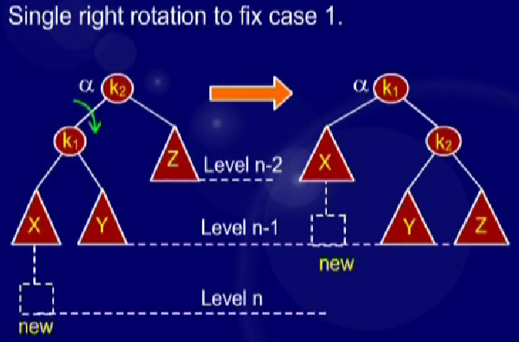
AVL Tree Building Example
AL

Slide 24
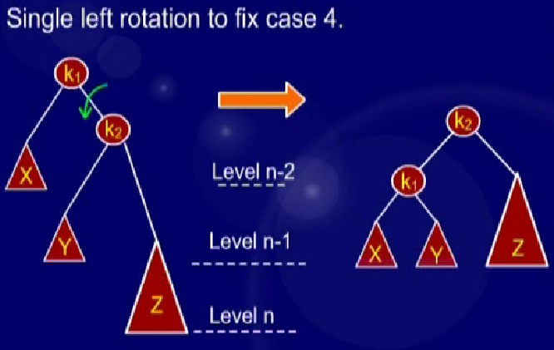
AVL Tree Building Example
AL

Slide 25
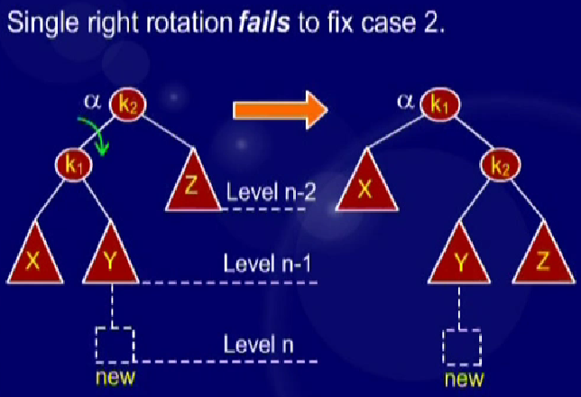
AVL Tree Building Example
AL

Slide 26
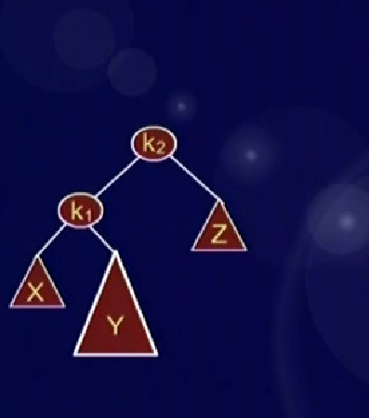
AVL Tree Building Example
AL

Slide 27
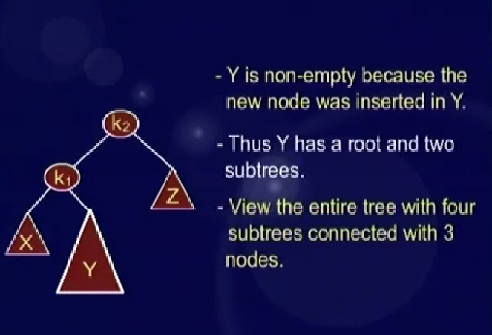
AVL Tree Building Example
AL

Slide 28
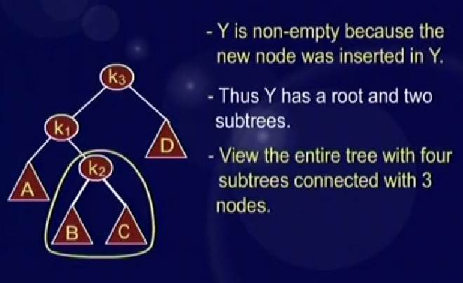
AVL Tree Building Example
AL

Slide 29
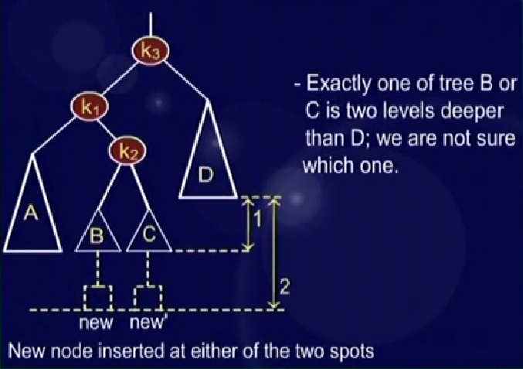
AVL Tree Building Example
AL

Slide 30
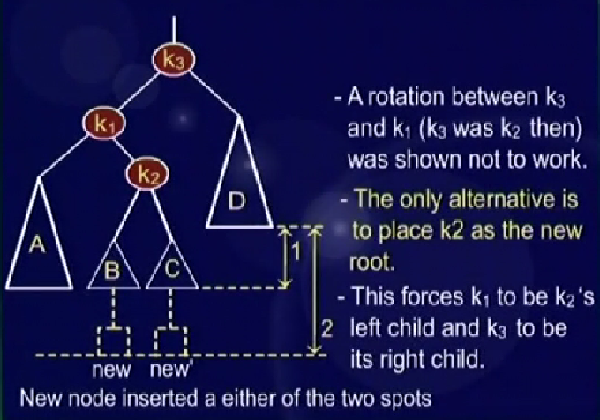
AVL Tree Building Example
AL

Slide 31
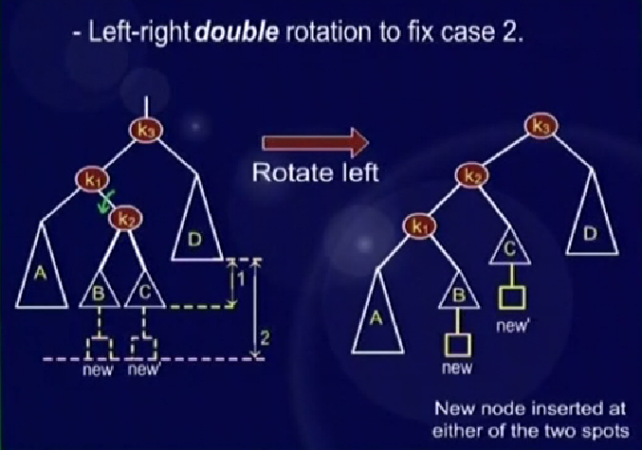
AVL Tree Building Example
AL

Slide 32
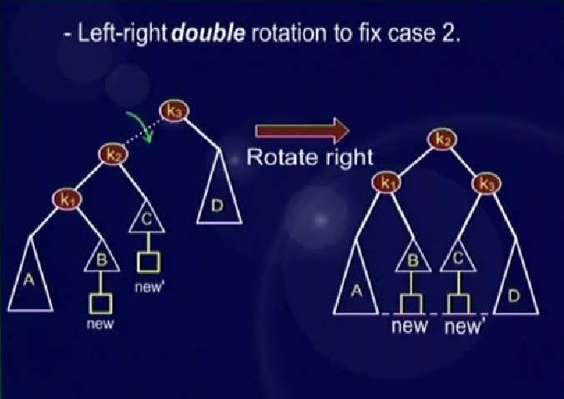
AVL Tree Building Example
AL

Slide 33
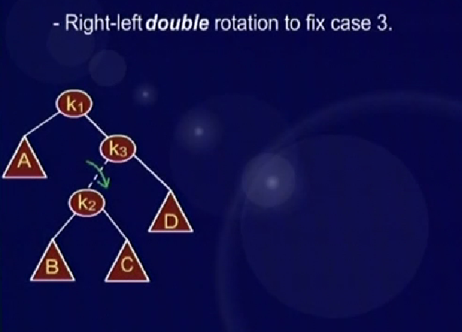
AVL Tree Building Example
AL

Slide 34
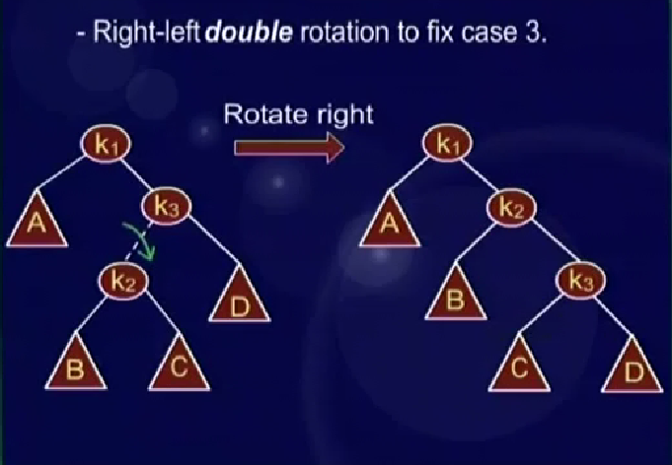
AVL Tree Building Example
AL

Slide 35
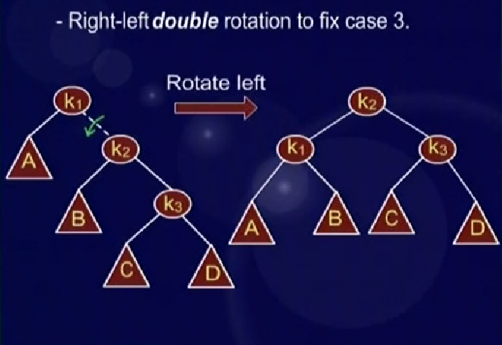
AVL Tree Building Example
AL

Slide 36
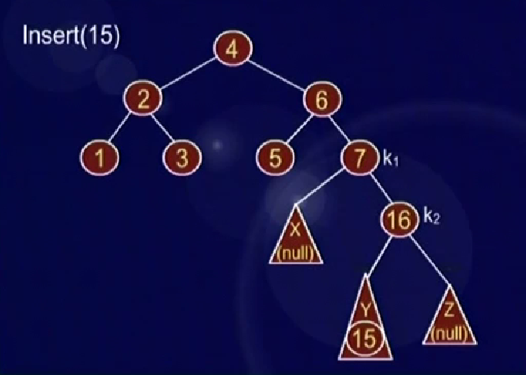
AVL Tree Building Example
AL

Slide 37
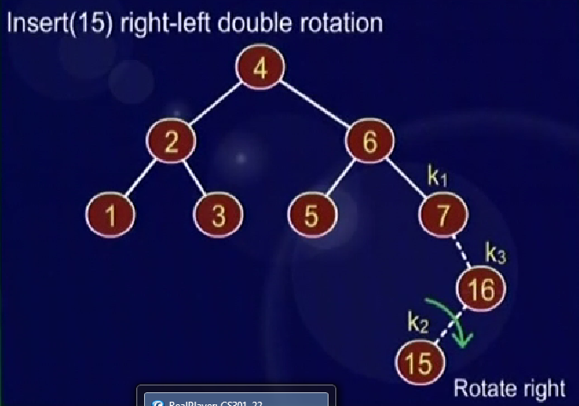
AVL Tree Building Example
AL

Slide 38
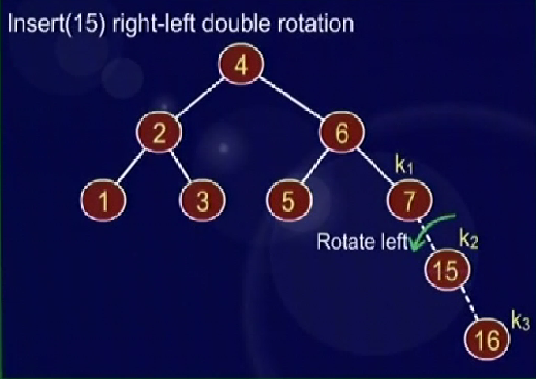
AVL Tree Building Example
AL

Slide 39
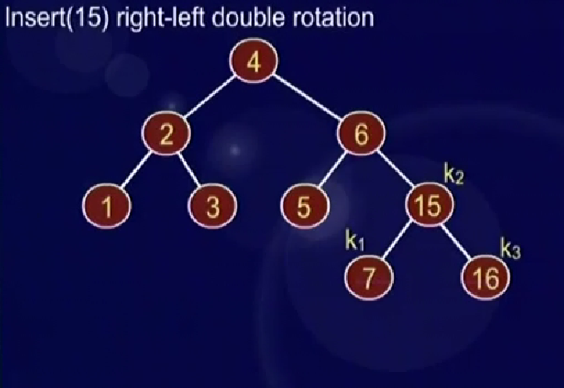
AVL Tree Building Example
AL

Slide 40
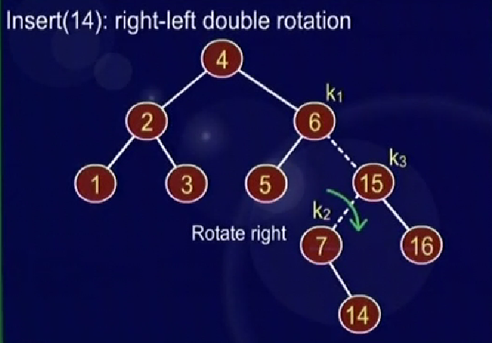
AVL Tree Building Example
AL

Slide 41
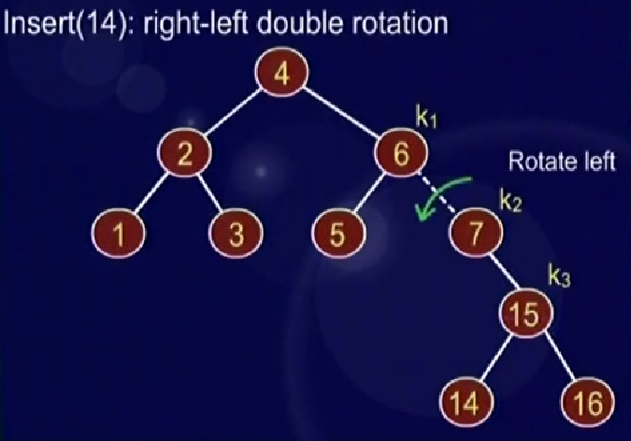
AVL Tree Building Example
AL

Slide 42
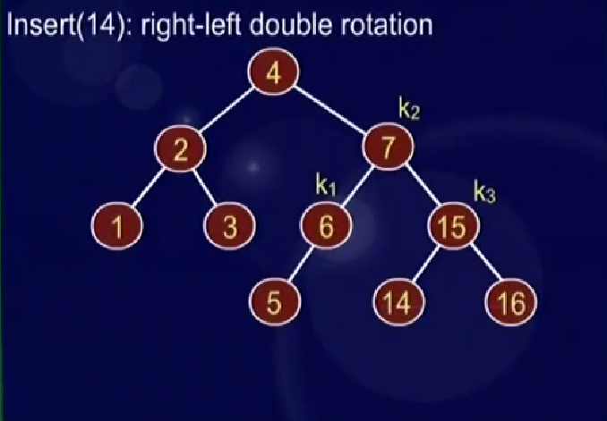
AVL Tree Building Example
AL

Slide 43
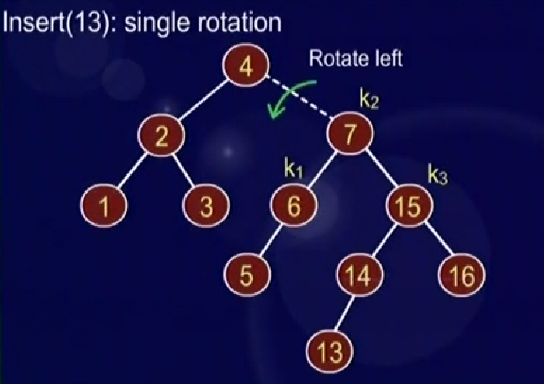
AVL Tree Building Example
AL

Slide 44
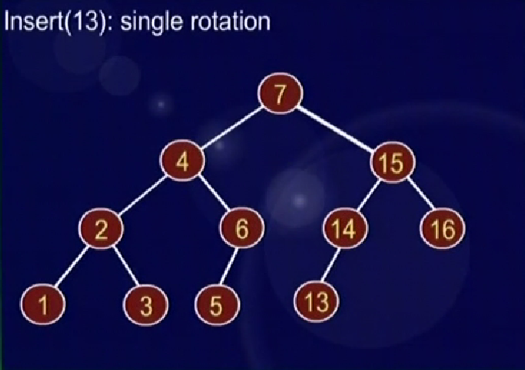
AVL Tree Building Example
AL

Slide 45
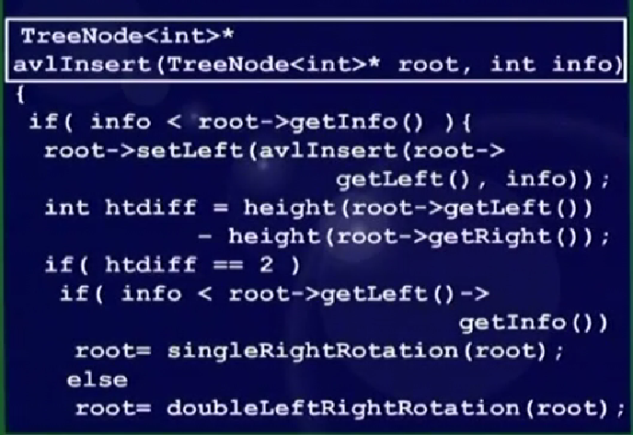
AVL Tree Building Example
AL

Slide 46
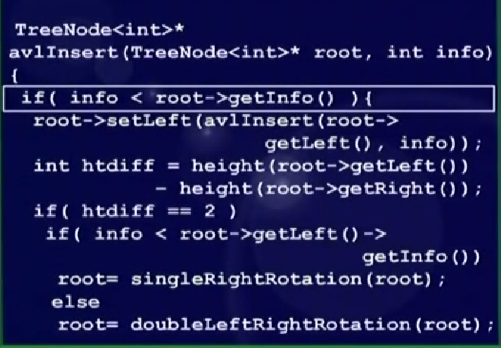
AVL Tree Building Example
AL

Slide 47
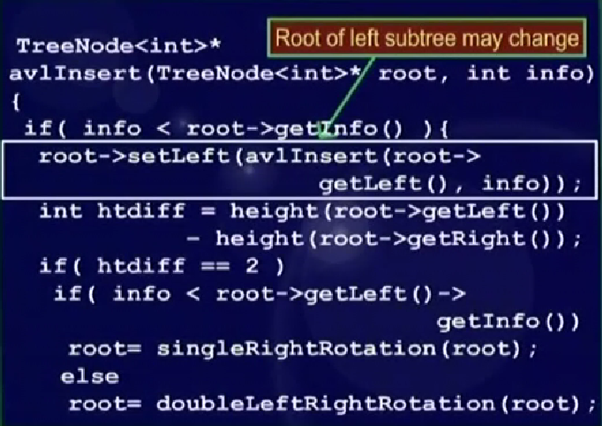
AVL Tree Building Example
AL

Slide 48
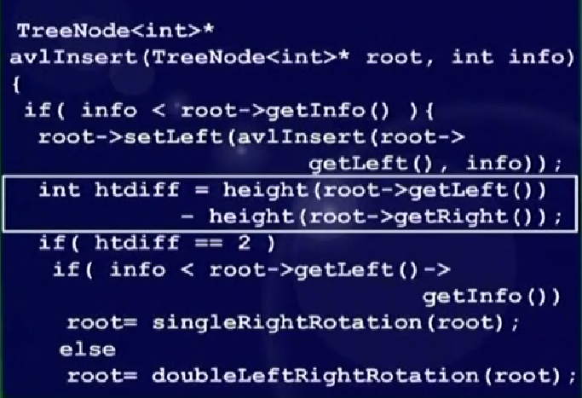
AVL Tree Building Example
AL

Slide 49
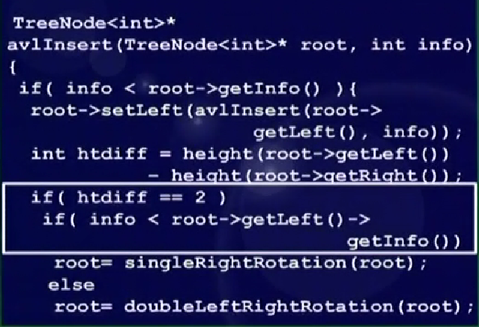
AVL Tree Building Example
AL

Slide 50
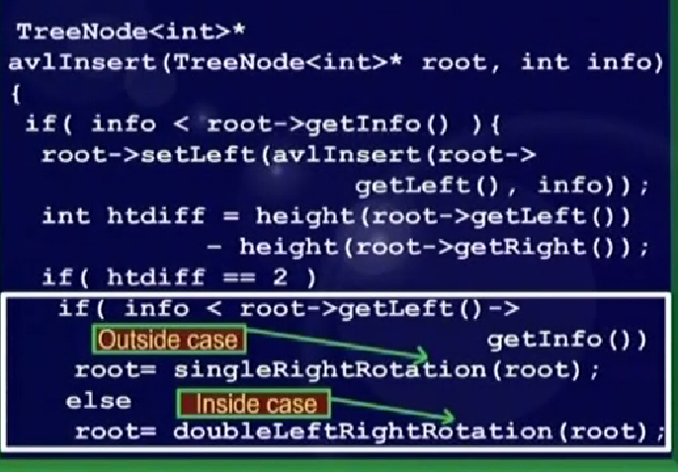
AVL Tree Building Example
AL

Slide 51
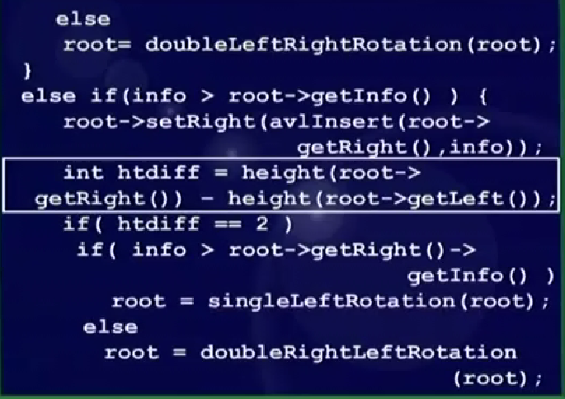
AVL Tree Building Example
AL

Slide 52
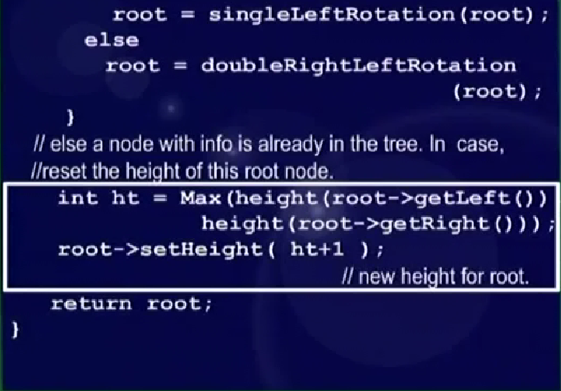
AVL Tree Building Example
AL

Slide 53
singleRightRotation

TreeNode<int>* singleRightRotation(TreeNode<int>* k2)
{
if( k2 == NULL ) return NULL;
// k1 (first node in k2's left subtree)
// will be the new root
TreeNode<int>* k1 = k2->getLeft();
// Y moves from k1's right to k2's left
k2->setLeft( k1->getRight() );
k1->setRight(k2);
// reassign heights. First k2
int h = Max(height(k2->getLeft()),
height(k2->getRight()));
k2->setHeight( h+1 );
// k2 is now k1's right subtree
h = Max( height(k1->getLeft()),
k2->getHeight());
k1->setHeight( h+1 );
return k1;
}
k₂
k₁
Z
Y
X
k₁
k₂
X
Z
Y
Notes:
Start of lecture 23

Slide 54
singleRightRotation
TreeNode<int>* singleRightRotation(TreeNode<int>* k2)
{
if( k2 == NULL ) return NULL;
// k1 (first node in k2's left subtree)
// will be the new root
TreeNode<int>* k1 = k2->getLeft();
// Y moves from k1's right to k2's left
k2->setLeft( k1->getRight() );
k1->setRight(k2);
// reassign heights. First k2
int h = Max(height(k2->getLeft()),
height(k2->getRight()));
k2->setHeight( h+1 );
// k2 is now k1's right subtree
h = Max( height(k1->getLeft()),
k2->getHeight());
k1->setHeight( h+1 );
return k1;
}

k₂
k₁
Z
Y
X
k₁
k₂
X
Z
Y

Slide 55
singleRightRotation
TreeNode<int>* singleRightRotation(TreeNode<int>* k2)
{
if( k2 == NULL ) return NULL;
// k1 (first node in k2's left subtree)
// will be the new root
TreeNode<int>* k1 = k2->getLeft();
// Y moves from k1's right to k2's left
k2->setLeft( k1->getRight() );
k1->setRight(k2);
// reassign heights. First k2
int h = Max(height(k2->getLeft()),
height(k2->getRight()));
k2->setHeight( h+1 );
// k2 is now k1's right subtree
h = Max( height(k1->getLeft()),
k2->getHeight());
k1->setHeight( h+1 );
return k1;
}
k₂
k₁

Z
Y
X
k₁
k₂
X
Z
Y

Slide 56
singleRightRotation
TreeNode<int>* singleRightRotation(TreeNode<int>* k2)
{
if( k2 == NULL ) return NULL;
// k1 (first node in k2's left subtree)
// will be the new root
TreeNode<int>* k1 = k2->getLeft();
// Y moves from k1's right to k2's left
k2->setLeft( k1->getRight() );
k1->setRight(k2);
// reassign heights. First k2
int h = Max(height(k2->getLeft()),
height(k2->getRight()));
k2->setHeight( h+1 );
// k2 is now k1's right subtree
h = Max( height(k1->getLeft()),
k2->getHeight());
k1->setHeight( h+1 );
return k1;
}
k₂
k₁
Z

Y
X
k₁
k₂
X
Z
Y

Slide 57
singleRightRotation
TreeNode<int>* singleRightRotation(TreeNode<int>* k2)
{
if( k2 == NULL ) return NULL;
// k1 (first node in k2's left subtree)
// will be the new root
TreeNode<int>* k1 = k2->getLeft();
// Y moves from k1's right to k2's left
k2->setLeft( k1->getRight() );
k1->setRight(k2);
// reassign heights. First k2
int h = Max(height(k2->getLeft()),
height(k2->getRight()));
k2->setHeight( h+1 );
// k2 is now k1's right subtree
h = Max( height(k1->getLeft()),
k2->getHeight());
k1->setHeight( h+1 );
return k1;
}
k₂
k₁
Z
Y
X

k₁
k₂
X
Z
Y

Slide 58
singleRightRotation
TreeNode<int>* singleRightRotation(TreeNode<int>* k2)
{
if( k2 == NULL ) return NULL;
// k1 (first node in k2's left subtree)
// will be the new root
TreeNode<int>* k1 = k2->getLeft();
// Y moves from k1's right to k2's left
k2->setLeft( k1->getRight() );
k1->setRight(k2);
// reassign heights. First k2
int h = Max(height(k2->getLeft()),
height(k2->getRight()));
k2->setHeight( h+1 );
// k2 is now k1's right subtree
h = Max( height(k1->getLeft()),
k2->getHeight());
k1->setHeight( h+1 );
return k1;
}
k₂
k₁
Z
Y
X
k₁
k₂

X
Z
Y

Slide 59
singleRightRotation
TreeNode<int>* singleRightRotation(TreeNode<int>* k2)
{
if( k2 == NULL ) return NULL;
// k1 (first node in k2's left subtree)
// will be the new root
TreeNode<int>* k1 = k2->getLeft();
// Y moves from k1's right to k2's left
k2->setLeft( k1->getRight() );
k1->setRight(k2);
// reassign heights. First k2
int h = Max(height(k2->getLeft()),
height(k2->getRight()));
k2->setHeight( h+1 );
// k2 is now k1's right subtree
h = Max( height(k1->getLeft()),
k2->getHeight());
k1->setHeight( h+1 );
return k1;
}
k₂
k₁
Z
Y
X
k₁
k₂
X
Z
Y


Slide 60
height
int height( TreeNode<int>* node )
{
if( node != NULL ) return node->getHeight();
return -1;
}


Slide 61
height
int height( TreeNode<int>* node )
{
if( node != NULL ) return node->getHeight();
return -1;
}


Slide 62
singleLeftRotation

TreeNode<int>* singleLeftRotation( TreeNode<int>* k1 )
{
if( k1 == NULL ) return NULL;
// k2 is now the new root
TreeNode<int>* k2 = k1->getRight();
k1->setRight( k2->getLeft() ); // Y
k2->setLeft( k1 );
// reassign heights. First k1 (demoted)
int h = Max(height(k1->getLeft()),
height(k1->getRight()));
k1->setHeight( h+1 );
// k1 is now k2's left subtree
h = Max( height(k2->getRight()),
k1->getHeight());
k2->setHeight( h+1 );
return k2;
}
k₁
k₂
X
Y
Z
k₂
k₁
X
Z
Y

Slide 63
singleLeftRotation
TreeNode<int>* singleLeftRotation( TreeNode<int>* k1 )
{
if( k1 == NULL ) return NULL;
// k2 is now the new root
TreeNode<int>* k2 = k1->getRight();
k1->setRight( k2->getLeft() ); // Y
k2->setLeft( k1 );
// reassign heights. First k1 (demoted)
int h = Max(height(k1->getLeft()),
height(k1->getRight()));
k1->setHeight( h+1 );
// k1 is now k2's left subtree
h = Max( height(k2->getRight()),
k1->getHeight());
k2->setHeight( h+1 );
return k2;
}
k₁

k₂
X
Y
Z
k₂
k₁
X
Z
Y

Slide 64
singleLeftRotation
TreeNode<int>* singleLeftRotation( TreeNode<int>* k1 )
{
if( k1 == NULL ) return NULL;
// k2 is now the new root
TreeNode<int>* k2 = k1->getRight();
k1->setRight( k2->getLeft() ); // Y
k2->setLeft( k1 );
// reassign heights. First k1 (demoted)
int h = Max(height(k1->getLeft()),
height(k1->getRight()));
k1->setHeight( h+1 );
// k1 is now k2's left subtree
h = Max( height(k2->getRight()),
k1->getHeight());
k2->setHeight( h+1 );
return k2;
}
k₁
k₂
X

Y
Z
k₂
k₁
X
Z
Y

Slide 65
singleLeftRotation
TreeNode<int>* singleLeftRotation( TreeNode<int>* k1 )
{
if( k1 == NULL ) return NULL;
// k2 is now the new root
TreeNode<int>* k2 = k1->getRight();
k1->setRight( k2->getLeft() ); // Y
k2->setLeft( k1 );
// reassign heights. First k1 (demoted)
int h = Max(height(k1->getLeft()),
height(k1->getRight()));
k1->setHeight( h+1 );
// k1 is now k2's left subtree
h = Max( height(k2->getRight()),
k1->getHeight());
k2->setHeight( h+1 );
return k2;
}
k₁
k₂
X
Y
Z

k₂
k₁
X
Z
Y

Slide 66
singleLeftRotation
TreeNode<int>* singleLeftRotation( TreeNode<int>* k1 )
{
if( k1 == NULL ) return NULL;
// k2 is now the new root
TreeNode<int>* k2 = k1->getRight();
k1->setRight( k2->getLeft() ); // Y
k2->setLeft( k1 );
// reassign heights. First k1 (demoted)
int h = Max(height(k1->getLeft()),
height(k1->getRight()));
k1->setHeight( h+1 );
// k1 is now k2's left subtree
h = Max( height(k2->getRight()),
k1->getHeight());
k2->setHeight( h+1 );
return k2;
}
k₁
k₂
X
Y
Z
k₂

k₁
X
Z
Y

Slide 67
singleLeftRotation
TreeNode<int>* singleLeftRotation( TreeNode<int>* k1 )
{
if( k1 == NULL ) return NULL;
// k2 is now the new root
TreeNode<int>* k2 = k1->getRight();
k1->setRight( k2->getLeft() ); // Y
k2->setLeft( k1 );
// reassign heights. First k1 (demoted)
int h = Max(height(k1->getLeft()),
height(k1->getRight()));
k1->setHeight( h+1 );
// k1 is now k2's left subtree
h = Max( height(k2->getRight()),
k1->getHeight());
k2->setHeight( h+1 );
return k2;
}
k₁
k₂
X
Y
Z
k₂
k₁
X
Z

Y

Slide 68
doubleRightLeftRotation

TreeNode<int>* doubleRightLeftRotation(TreeNode<int>* k1)
{
if( k1 == NULL ) return NULL;
// single right rotate with k3 (k1's right child)
k1->setRight( singleRightRotation(k1->getRight()));
// now single left rotate with k1 as the root
return singleLeftRotation(k1);
}
k₁
k₁
k₃
k₂
A
A
k₂
k₃
D
B
B
C
C
D

Slide 69
doubleRightLeftRotation
TreeNode<int>* doubleRightLeftRotation(TreeNode<int>* k1)
{
if( k1 == NULL ) return NULL;
// single right rotate with k3 (k1's right child)
k1->setRight( singleRightRotation(k1->getRight()));
// now single left rotate with k1 as the root
return singleLeftRotation(k1);
}

k₁
k₁
k₃
k₂
A
A
k₂
k₃
D
B
B
C
C
D

Slide 70
doubleRightLeftRotation
TreeNode<int>* doubleRightLeftRotation(TreeNode<int>* k1)
{
if( k1 == NULL ) return NULL;
// single right rotate with k3 (k1's right child)
k1->setRight( singleRightRotation(k1->getRight()));
// now single left rotate with k1 as the root
return singleLeftRotation(k1);
}

k₁
k₂
k₂
k₁
k₃
A
k₃
B
C
D
B
A
C
D

Slide 71
doubleRightLeftRotation

TreeNode<int>* doubleLeftRightRotation(TreeNode<int>* k3)
{
if( k3 == NULL ) return NULL;
// single left rotate with k1 (k3's left child)
k3->setLeft( singleLeftRotation(k3->getLeft()));
// now single right rotate with k3 as the root
return singleRightRotation(k3);
}
k₃
k₃
k₁
k₂
D
D
k₂
k₁
A
C
B
C
A
B

Slide 72
doubleRightLeftRotation
TreeNode<int>* doubleLeftRightRotation(TreeNode<int>* k3)
{
if( k3 == NULL ) return NULL;
// single left rotate with k1 (k3's left child)
k3->setLeft( singleLeftRotation(k3->getLeft()));
// now single right rotate with k3 as the root
return singleRightRotation(k3);
}

k₃
k₃
k₁
k₂
D
D
k₂
k₁
A
C
B
C
A
B

Slide 73
doubleRightLeftRotation
TreeNode<int>* doubleLeftRightRotation(TreeNode<int>* k3)
{
if( k3 == NULL ) return NULL;
// single left rotate with k1 (k3's left child)
k3->setLeft( singleLeftRotation(k3->getLeft()));
// now single right rotate with k3 as the root
return singleRightRotation(k3);
}

k₃
k₂
k₂
k₁
k₃
D
k₁
B
C
D
C
A
A
B

